Slide 1

E-COMMERCE ORDER MANAGEMENT SYSTEM
Capstone project review-2
BATCH NUMBER:11
Presented by:
Academic Year: 2026-2027
25B11AI911-P.CHANDRIKA(AIML)
25B11AI332-G.ANVITHA(AIML)
25B11AI420-J.TANISHKA(AIML)
25B11AIB23-S.SUDHADEVI(AIML)
Under esteemed guidance of
Dr P Kishorekumar
Associate Professor
Department of AIML
Aditya University

Slide 2
Project Overview
The E-Commerce Order Management System is designed to manage online customer orders efficiently.
It helps customers place orders for products through an online platform.
The system stores customer, product, order, and payment details.
Admin can add, update, and manage products.
The system tracks order status such as Pending, Confirmed, Shipped, Delivered, and Cancelled.
It helps reduce manual work and improves order management.
Domain: E-Commerce / Online Shopping
Technologies: C++ / DBMS / SQL (modify according to your actual project)

Slide 3
Existing System and Proposed System
Existing System | Proposed Database System
Manual order records | Centralized database for orders
Customer and product data stored separately | Related tables for Customers, Products, Orders and Payments
Duplicate or inconsistent order information | Keys and constraints maintain data integrity
Difficult to track order status | Order status tracking: Pending, Confirmed, Shipped, Delivered, Cancelled
Time-consuming order searches | SQL queries for quick order retrieval
Difficult to generate reports | SQL joins, aggregation and views for reports

Slide 4
Functional Requirements
Customer Management – Manage customer details, contact information, and account records.
Product Management – Manage product details, categories, prices, and stock information.
Order Management – Manage order dates, quantities, total amounts, and order status.
Payment Management – Manage payment methods, payment dates, and payment status.
Delivery Management – Manage delivery address, delivery date, and delivery status.
Order Tracking – Track the progress of an order from placement to final delivery.
Database Management – Maintain relationships between customers, products, orders, payments, and deliveries using primary and foreign keys.

Slide 5
Database Schema Used for Implementation
Table | Primary Key | Foreign Keys
CUSTOMER | PK: CUSTOMER_ID | -------------
CATEGORY | PK: CATEGORY_ID | -------------
PRODUCT | PK: Product_ID | FK: CATEGORY_ID
ORDER | PK: ORDER_ID | FK: CUSTOMER_ID
ORDER_ITEM | PK: ORDER_ITEM_ID | FK: ORDER_ID, Product_ID
PAYMENT | PK: PAYMENT_ID | FK: ORDER_ID
DELIVERY | PK: DELIVERY_ID | FK: ORDER_ID

Slide 6
Table Design and Constraints
Table | Key / Validation Rules
Customer | PK Customer_ID; NOT NULL Customer_Name; UNIQUE Email
Category | PK Category_ID; NOT NULL Category_Name
Product | PK Product_ID; NOT NULL Product_Name; CHECK Price > 0; CHECK Stock_Quantity >= 0; FK Category_ID
Order | PK Order_ID; NOT NULL Order_Date; CHECK Total_Amount >= 0; FK Customer_ID
Order_Item | PK Order_Item_ID; NOT NULL Quantity; CHECK Quantity > 0; CHECK Subtotal >= 0; FKs Order_ID, Product_ID
Payment | PK Payment_ID; NOT NULL Payment_Method; FK Order_ID
Delivery | PK Delivery _ID; NOT NULL Delivery _ Address; FK Order_ ID

Slide 7
Normalization up to 3NF
1NF – First Normal Form
Each table contains atomic (single) values.
No repeating groups or multi-valued attributes.
Each record is uniquely identified using a Primary Key.
Example: ORDER_ITEM stores one product entry per order item.
2NF – Second Normal Form
The database is already in 1NF.
Non-key attributes depend on the whole primary key.
Product details are separated into PRODUCT.
Customer details are separated into CUSTOMER.
Order details are separated into ORDER.
3NF – Third Normal Form
The database is already in 2NF.
Non-key attributes depend only on the primary key.
Category information is stored separately in CATEGORY.
Payment information is stored in PAYMENT.
Delivery information is stored in DELIVERY.
This reduces data redundancy and improves data consistency.
Final Statement
The proposed database is normalized up to 3NF by separating customer, category, product, order, order-item, payment, and delivery information into related tables using primary and foreign keys.

Slide 8
SQL Implementation – DDL
DDL Commands Used
CREATE TABLE – Creates the database tables.
PRIMARY KEY – Uniquely identifies each record.
FOREIGN KEY – Establishes relationships between tables.
NOT NULL – Ensures required fields contain values.
UNIQUE – Prevents duplicate values.
CHECK – Validates values based on conditions.
Tables Created
CUSTOMER
CATEGORY
PRODUCT
ORDER
ORDER_ITEM
PAYMENT
DELIVERY

Slide 9
CREATE TABLE CUSTOMER (
CUSTOMER_ID INT PRIMARY KEY,
CUSTOMER_NAME VARCHAR(100) NOT NULL,
Email VARCHAR(100) UNIQUE,
Phone VARCHAR(15),
Address VARCHAR(200)
);
CREATE TABLE CATEGORY (
CATEGORY_ID INT PRIMARY KEY,
CATEGORY_NAME VARCHAR(100) NOT NULL,
Description VARCHAR(200)
);
CREATE TABLE PRODUCT (
PRODUCT_ID INT PRIMARY KEY,
PRODUCT_NAME VARCHAR(100) NOT NULL,
Price DECIMAL(10,2) CHECK (Price > 0),
STOCK_QUANTITY INT CHECK (STOCK_QUANTITY >= 0),
CATEGORY_ID INT,
FOREIGN KEY (CATEGORY_ID) REFERENCES CATEGORY(CATEGORY_ID)
);

Slide 10
SQL Implementation – DML
DML Commands Used
INSERT – Add customer, category, product, order, payment, and delivery records.
UPDATE – Modify product stock, order status, payment status, or delivery status.
DELETE – Remove records when required.
SELECT – Retrieve customer, product, order, payment, and delivery information.

Slide 11
SQL Implementation – DML
-- Insert customer
INSERT INTO CUSTOMER
VALUES (1, ‘ravi', ‘ravi@gmail.com', '9876543210', 'Hyderabad');
-- Insert category
INSERT INTO CATEGORY
VALUES (101, 'Electronics', 'Electronic Products');
-- Insert product
INSERT INTO PRODUCT
VALUES (201, 'Headphones', 1500.00, 20, 101);
-- Update product stock
UPDATE PRODUCT
SET STOCK_QUANTITY = 19
WHERE PRODUCT_ID = 201;
-- Update order status
UPDATE `ORDER`
SET ORDER_STATUS = 'Shipped'
WHERE ORDER_ID = 301;
-- Retrieve orders
SELECT * FROM `ORDER`;
-- Delete a product
DELETE FROM PRODUCT
WHERE PRODUCT_ID = 201;

Slide 12
DQL – Data Retrieval
Filter records using WHERE.
SELECT records from project tables.
Sort records using ORDER BY.
Use DISTINCT, LIKE, IS NULL / IS NOT NULL where relevant.
Retrieve only the required columns.
Use JOIN to retrieve data from related tables.
Frame queries as meaningful E-Commerce order management questions

Slide 13
SQL Queries – Joins
Use INNER JOIN to combine matching records from related tables.
Join CUSTOMER and ORDER using CUSTOMER_ID.
Join PRODUCT and CATEGORY using CATEGORY_ID.
Join ORDER and ORDER_ITEM using ORDER_ID.
Join ORDER_ITEM and PRODUCT using PRODUCT_ID.
Join ORDER with PAYMENT and DELIVERY using ORDER_ID.
Use joins to retrieve complete customer, product, order, payment, and delivery information.
Example
SELECT C.CUSTOMER_NAME, O.ORDER_ID, O.ORDER_DATE, O.TOTAL_AMOUNT
FROM CUSTOMER C
JOIN `ORDER` O
ON C.CUSTOMER_ID = O.CUSTOMER_ID;

Slide 14
SQL Queries – Aggregate Functions
Use COUNT() to count customers, products, or orders.
Use SUM() to calculate total order amounts or sales.
Use AVG() to calculate the average order amount or product price.
Use MAX() to find the highest order amount or product price.
Use MIN() to find the lowest order amount or product price.
Use GROUP BY to generate category-wise or status-wise summaries.
Use HAVING to filter grouped results.
Example
SELECT ORDER_STATUS, COUNT(*) AS Total_Orders
FROM `ORDER`
GROUP BY ORDER_STATUS;

Slide 15
CRUD Operations
Operation | SQL Command | Example
Create | INSERT | Add a new product
Read | SELECT | View order details
Update | UPDATE | Change order status
Delete | DELETE | Remove a product

Slide 16
Views
Create Views to display frequently required information.
Use views to combine data from related tables.
Create an Order Details View to display customer and order information.
Create a Product Details View to display product and category information.
Create a Payment & Delivery View to display order payment and delivery status.
Views simplify data retrieval and improve database usability.
Example:
CREATE VIEW Order _ Details AS
SELECT C.CUSTOMER_NAME, O.ORDER_ID,
O.ORDER_DATE, O.TOTAL_AMOUNT,
O.ORDER_STATUS
FROM CUSTOMER C
JOIN `ORDER` O
ON C.CUSTOMER_ID = O.CUSTOMER_ID;

Slide 17
Data Integrity and Validation
Constraint | Purpose | Example in E-Commerce System
PRIMARY KEY | Uniquely identifies each record | CUSTOMER_ID
FOREIGN KEY | Maintains relationship between tables | CUSTOMER_ID in ORDER
NOT NULL | Prevents empty values | CUSTOMER_NAME
UNIQUE | Prevents duplicate values | Email
CHECK | Validates allowed values | Price > 0
REFERENTIAL INTEGRITY | Ensures valid table relationships | CATEGORY_ID in PRODUCT
DATA VALIDATION | Maintains accurate and consistent data | Valid price, quantity and status

Slide 18
SQL Output and Screenshots
Show database and all seven table creation screenshots.
Show sample records inserted into CUSTOMER, CATEGORY, PRODUCT, ORDER, ORDER_ITEM, PAYMENT, and DELIVERY tables.
Show important DDL, DML, and DQL query outputs.
Include screenshots for Joins, Aggregate Functions, CRUD Operations, and Views.
Show validation/error results, such as duplicate Primary Key or invalid Foreign Key.
Replace all documentation placeholders with actual SQL execution screenshots.

Slide 19
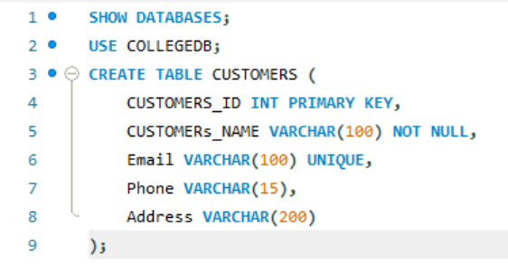
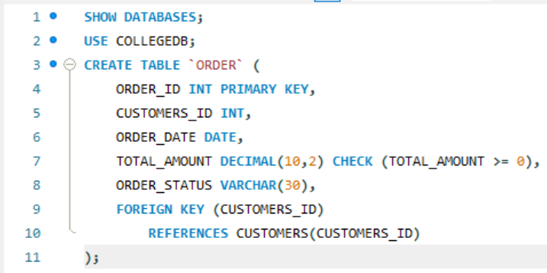
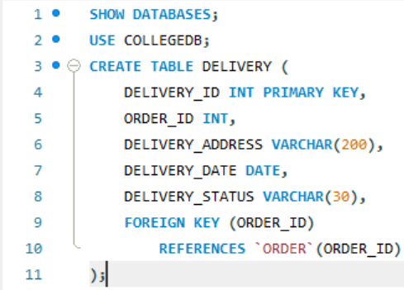
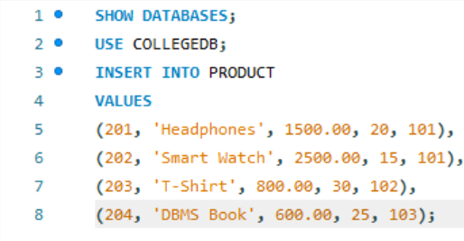
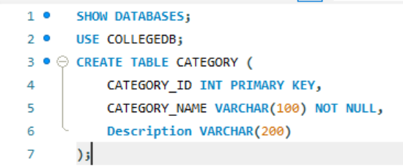
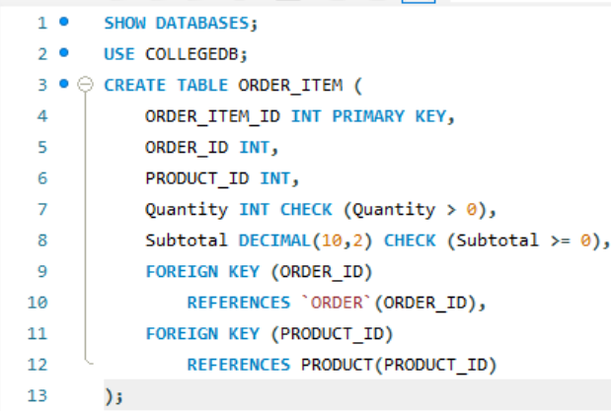
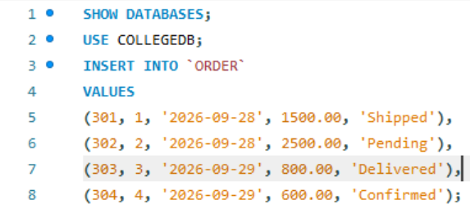
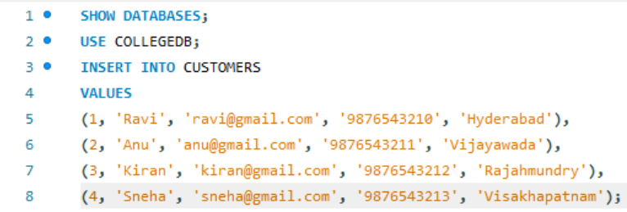
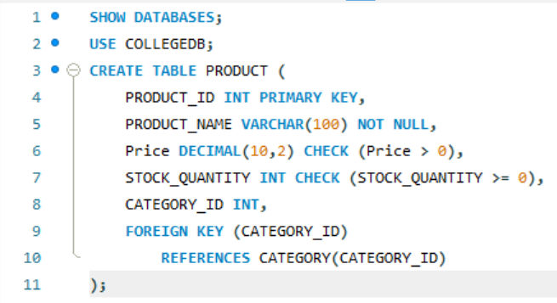
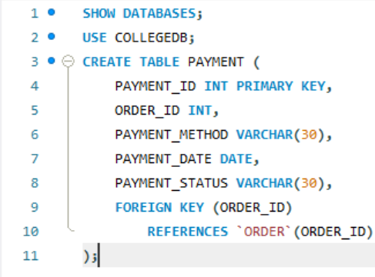
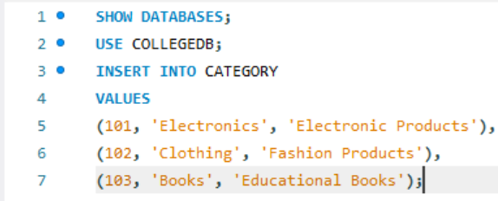
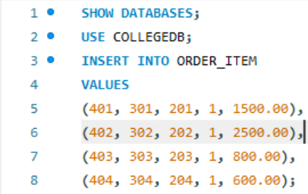
DDL – Create Tables:
CUSTOMER
ORDER
DELIVERY
Product
CATEGORY
ORDER_ITEM
DML – INSERT Records:
Order
Customer
PRODUCT
PAYMENT
Category
Order Item

Slide 20
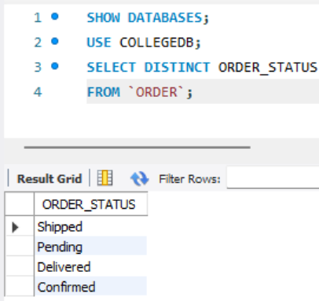
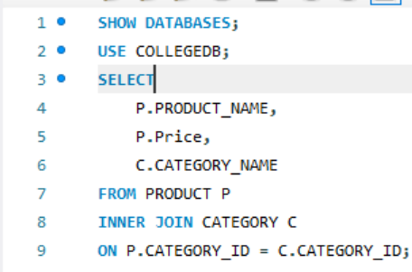
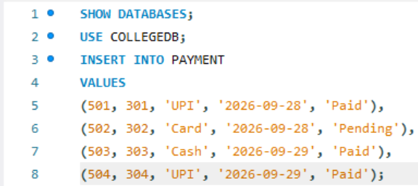
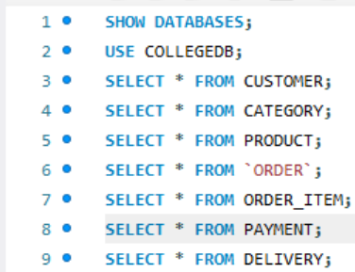
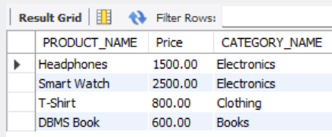
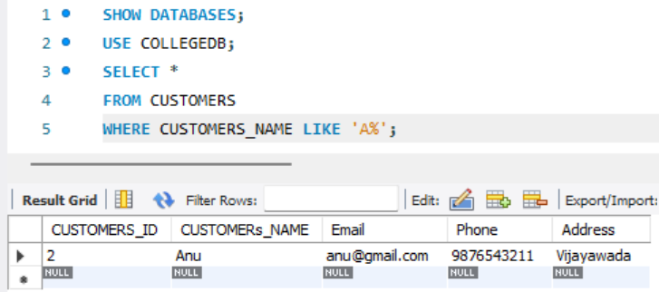
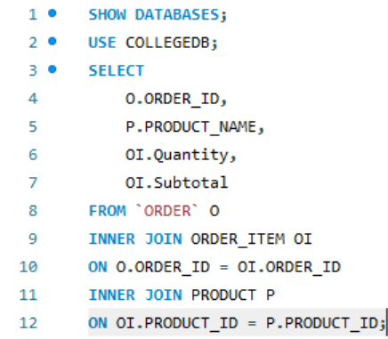
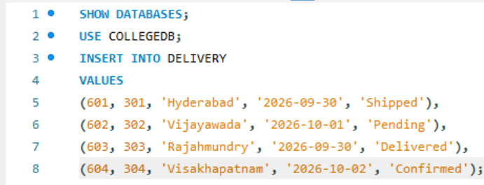
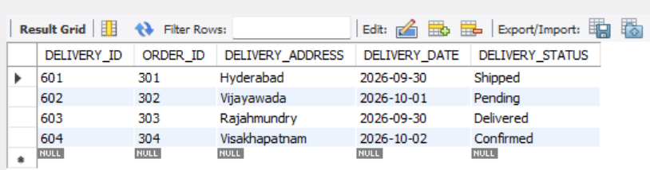
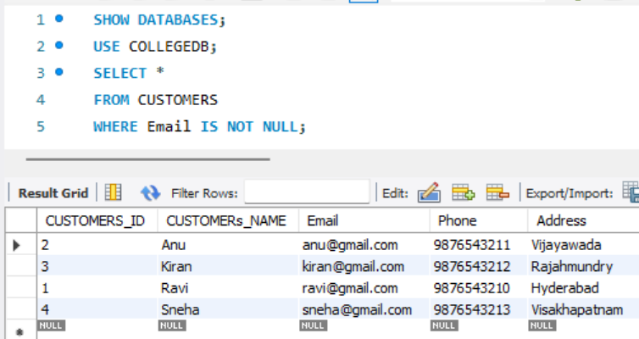
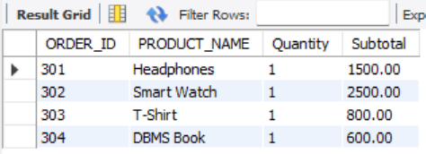
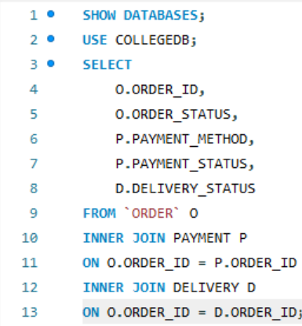
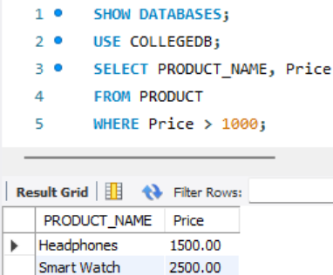
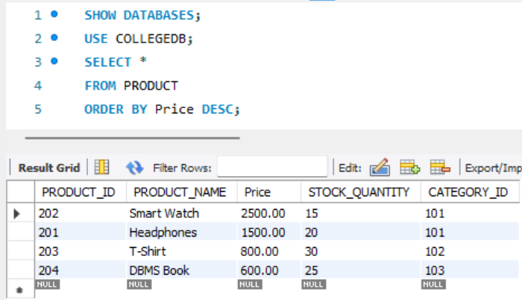
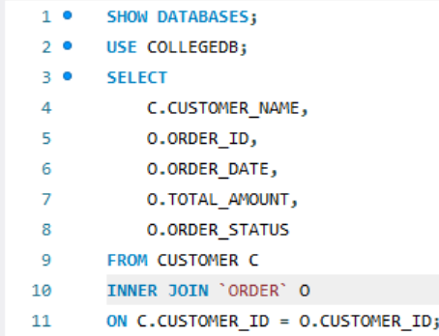
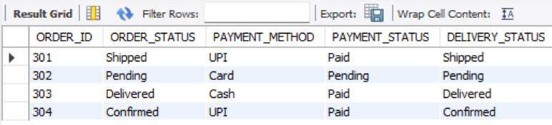
DISTINCT
Product + Category
Payment
DQL – Data Retrieval:
LIKE
Order + Order Item + Product
Delivery
OUTPUT:
IS NOT NULL
Order + Payment + Delivery
WHERE
ORDER BY
SQL Queries – Joins
Customer + Order

Slide 21
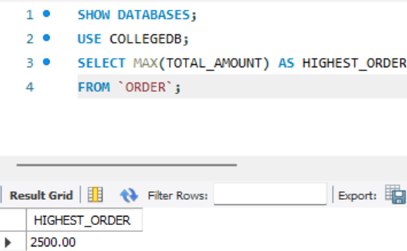
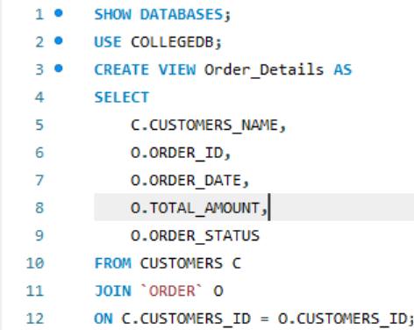
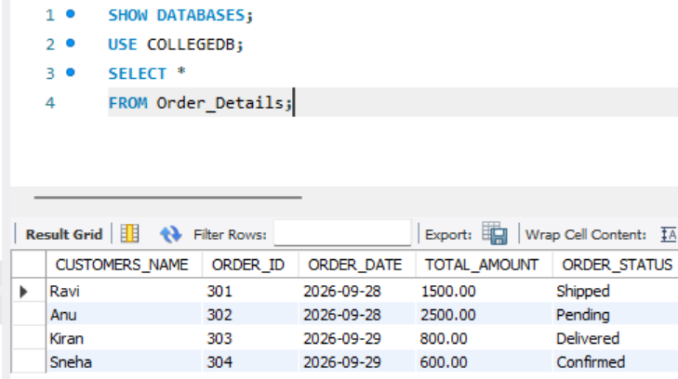
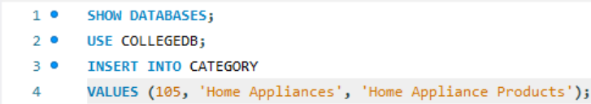
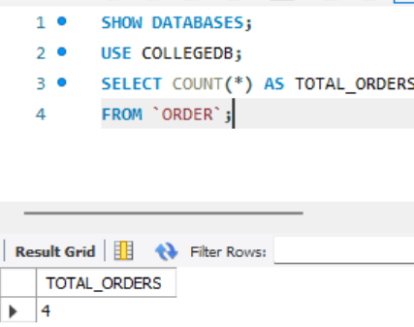
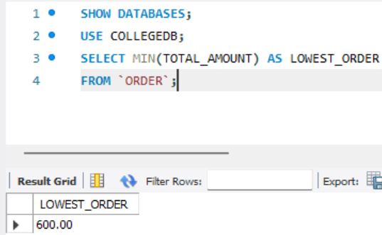
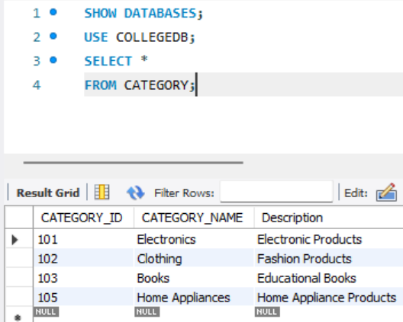
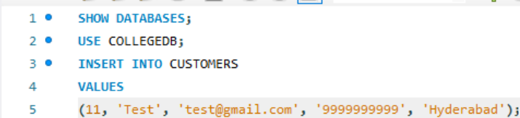
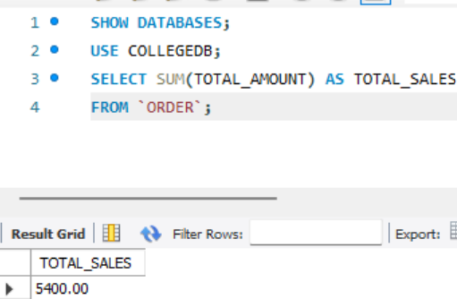
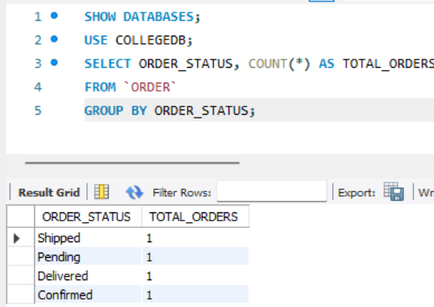
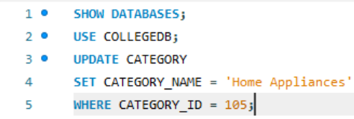
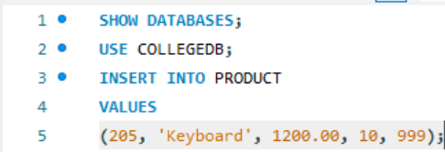
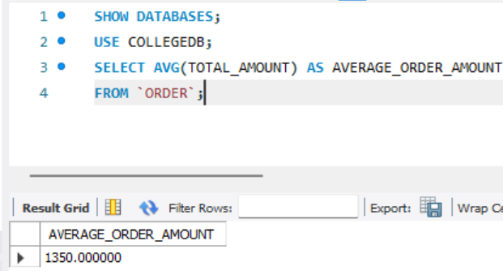
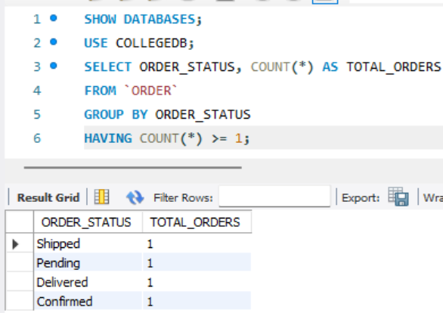
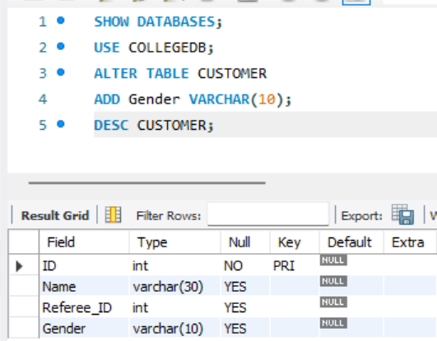
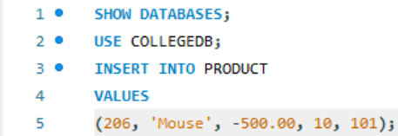
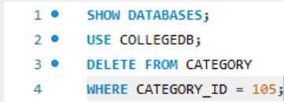
View:
Display View
MAX
CRUD Operations:
CREATE
Aggregate Functions:
COUNT
MIN
READ
Data Integrity / Validation:
Duplicate Primary Key Test
SUM
GROUP BY
UPDATE
Invalid Foreign Key Test
AVG
HAVING
CHECK Constraint Test
ALTER TABLE
DELETE

Slide 22
Query Coverage for Demonstration
Category | Demonstration
Basic SELECT | 3–5 queries on CUSTOMER, PRODUCT, ORDER
Filtering / Sorting | 3–5 queries using WHERE, LIKE, ORDER BY
Joins | 5+ meaningful multi-table queries
Aggregation | 5+ COUNT, AVG, MIN, MAX, SUM queries
GROUP BY / HAVING | 2–3 queries for order/category analysis
CRUD | At least one example for INSERT, SELECT, UPDATE and DELETE
Views | 1–2 meaningful views for order details
Validation | At least 2 constraint demonstrations

Slide 23
Live Database Demonstration – Recommended Order
Open the E-Commerce database/schema.
Show the 7 tables and their relationships.
Show table structures and constraints.
Display the inserted sample data.
Demonstrate DDL, DML, and DQL queries.
Demonstrate CRUD operations.
Run JOIN and Aggregate Function queries.
Demonstrate the Order Details View.
Demonstrate data validation and integrity constraints.
Explain normalization up to 3NF and answer questions.

Slide 24
Conclusion
The implemented database follows the design developed for the E-Commerce Order Management System.
The seven related tables organize customers, categories, products, orders, order items, payments, and deliveries.
Constraints and normalization up to 3NF support data integrity and reduce redundancy.
SQL operations demonstrate creation, modification, retrieval, CRUD, joins, aggregation, and views.
The database provides a foundation for efficient order, payment, and delivery management.

Slide 25
Future Enhancements
Role-based access for administrators, customers, and authorized users.
Product inventory and stock management.
Online payment gateway integration and payment tracking.
Real-time order and delivery tracking.
Automated sales reports and analytics dashboards.
Backup, recovery, audit logging, and stronger database security.
Web or mobile application interface for customers and administrators.

Slide 26
References
Korth, H. F., Silberschatz, A., and Sudarshan, S., Database System Concepts, McGraw Hill.
Elmasri, R. and Navathe, R., Fundamentals of Database Systems, Pearson.
Course lecture notes, laboratory exercises, and approved DBMS learning resources.

Slide 27
Final Review Checklist
Review Area | What students must demonstrate
Database Design | Title, problem, objectives, ER diagram, relational schema
Implementation | Database and all 7 project tables created
Constraints | PK, FK, NOT NULL, UNIQUE, CHECK / DEFAULT
Sample Data | All tables populated with valid records
SQL | DDL, DML, DQL demonstrated
CRUD | Create, Read, Update, Delete demonstrated
Queries | Joins, aggregates, GROUP BY / HAVING, views
Normalization | UNF → 1NF → 2NF → 3NF explained
Integrity | Duplicate IDs, invalid references, invalid values tested
Documentation | ER diagram, schema, SQL outputs and screenshots
Presentation | Working database demonstrated live

